Slide 1
ClubUML - 2014
Potential Extensions
by Vishal Patel

Slide 2
Fix Bugs & Make More Stable & User Friendly
value of errors messages vs. throwing exceptions vs. not showing anything
i.e. not being to upload since no user is added, but prior it appears as you can still upload
development time and effort

Slide 3
Adding Posts / Messages
Comment is available right now just for promoting
But have the ability to add comments at specific drawings when viewing.
Have others comment to somebody else’s comment
i.e. FaceBook Tags

Slide 4
Inspiration for collaboration comes from SmartBear’s Code Collaborator

Slide 5
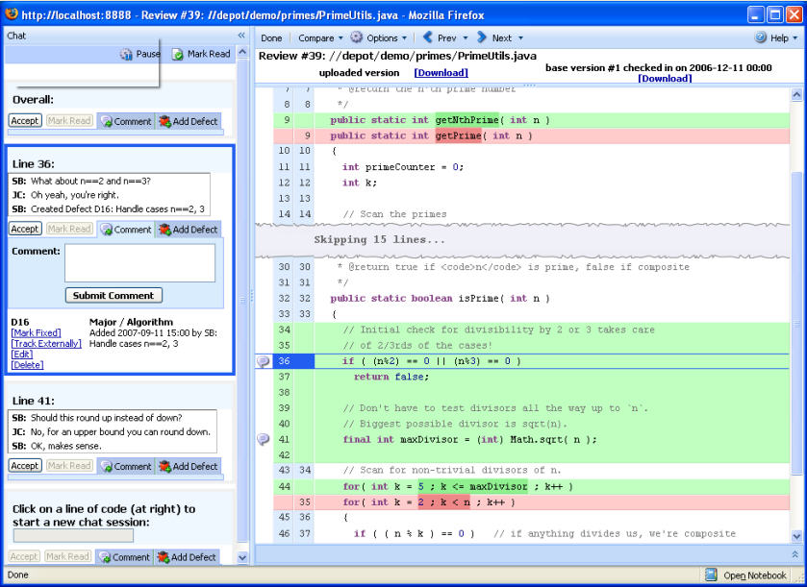

Slide 6
Auto Generated Emails on Uploads of Diagrams
Easily notify Project members a upload has been made to invoke discussion

Slide 7
Additional Diagram Support – State Machines
State Machines being another useful diagram

Slide 8
Add Estimation Calculator
Have ability to fill in various pieces into a calculator and have it estimate staff required or effort needed to complete a project

Slide 9
